Slide 1
Distributed Systems 15-440 / 15-640
Fall 2015

Slide 2
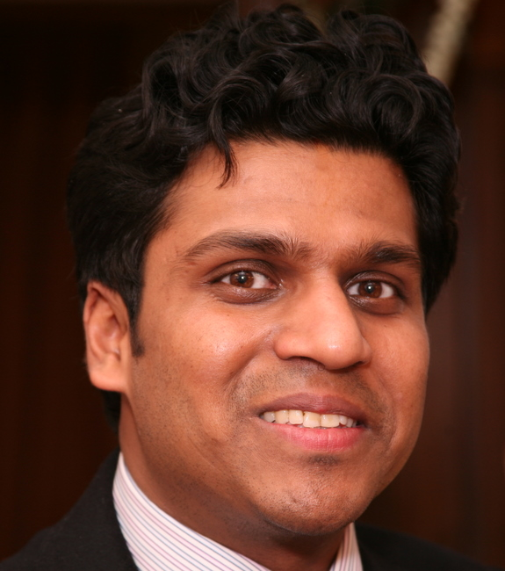
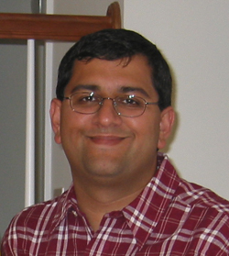
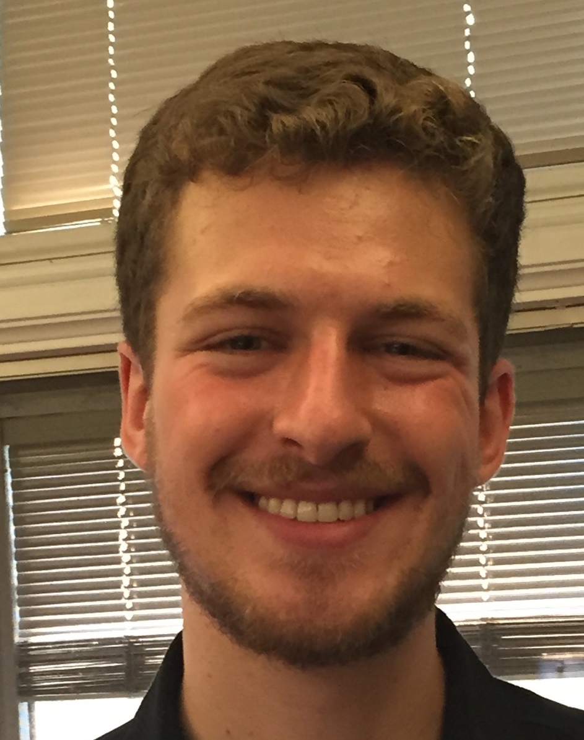
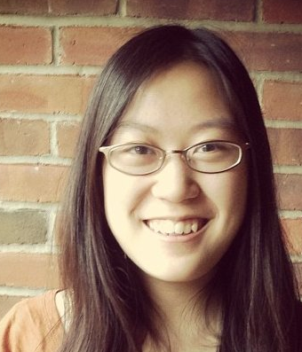
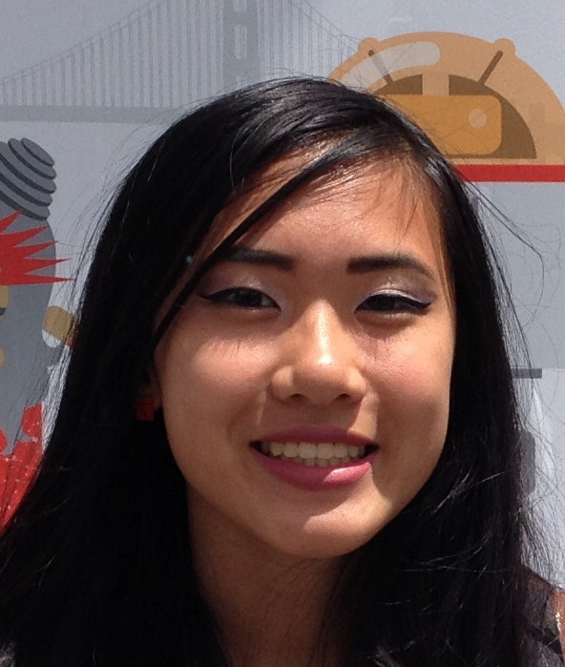


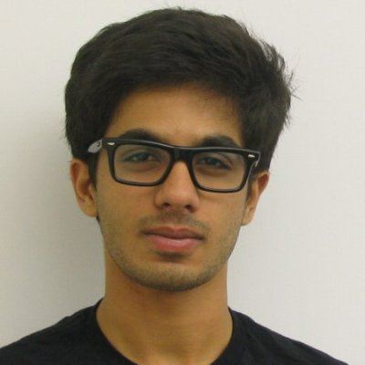
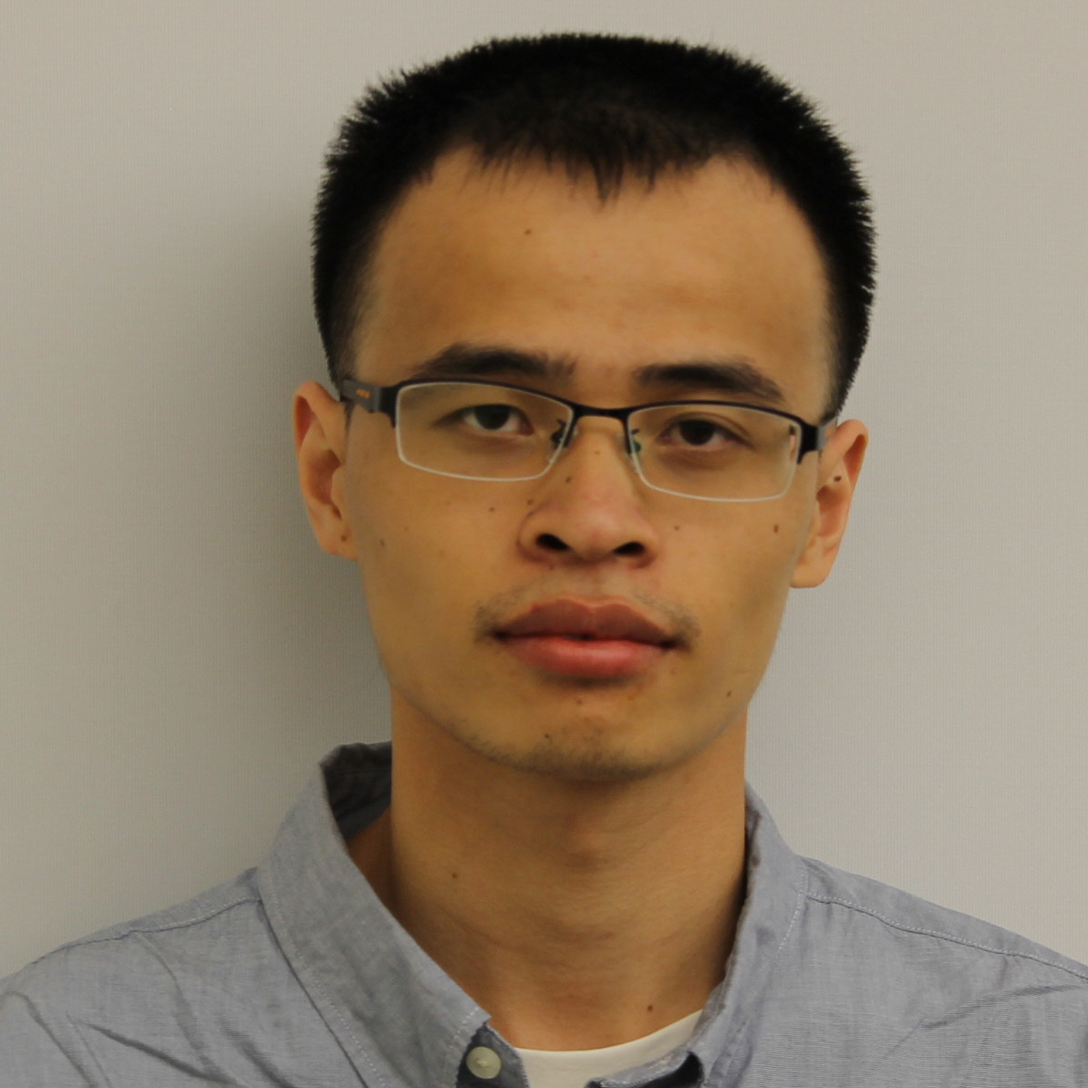

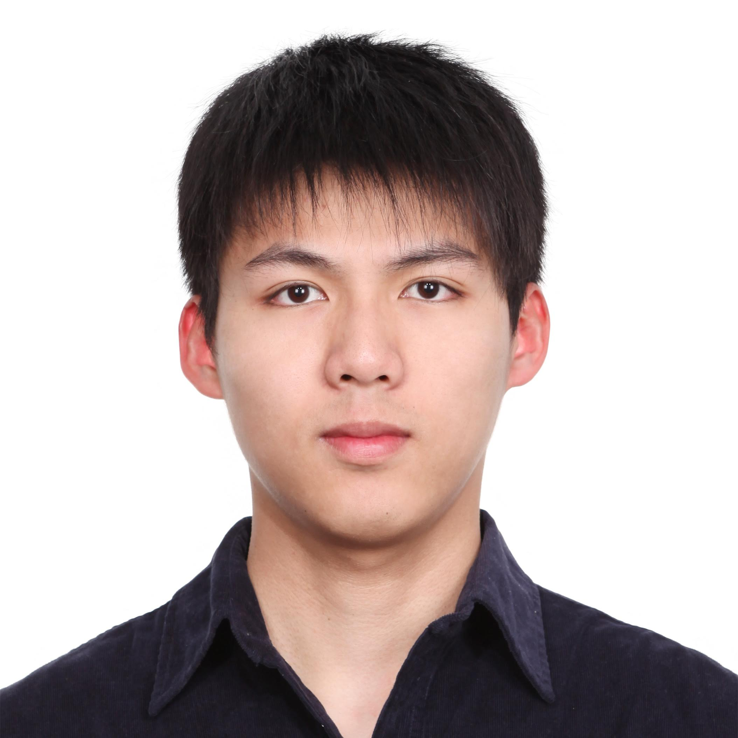
Welcome! Course Staff
Instructors
Yuvraj Agarwal
Srini Seshan
9 TA’s
Aaron Friedlander
Esther Wang
Marisa Chang
Joshua Gluck
Varun Saravgi
Arjun Puri
Chao Xin
Adhish Ramkumar
Xiaoxiang Wu

Slide 3
Course Logistics
Course Policies
Class web page: http://www.cs.cmu.edu/~srini/15-440/
Piazza: https://piazza.com/cmu/fall2015/1544015640
Obligatory discussion of {late days, cheating, etc.}
Waitlist!
No recitations this year, extra TA hours if needed (??)
Office hours / TAs are on class web page (keep checking)
Go work through the Tour of Go!
https://tour.golang.org/welcome/1

Slide 4
Waitlist
Waitlist of unprecedented size. Keep coming to class, because we don’t really know yet how it will work out.
Registered: 79 (15-440) + 58 (15-640)
Waitlisted: 23 (15-440) + 192 (!!!!!)
The bad news: Not everyone will get in. We are by law limited to physical classroom size. This is not subject to negotiation.
The plea: Not serious about the class? PLEASE DROP SOON.
The strategy:
Attend class!
If class is on immediate graduation path, have academic advisor email us.

Slide 5
Processing WL/Enroll
You will not be able to take the class if:
If not taken 213/513 at CMU *before*
If you are an UGRAD and lower than a “C” in 213
If you are a Grad and lower than a “B-” in 213/513
Priority order
Required: CS Ugrad, MSCS, MSDC, MITS
Email from faculty advisor
… then WL rank
Notes:
To clarify: this applies even if you are currently enrolled or are on the wait list. It seems that the Registrar has not been enforcing pre-requisites properly.

Slide 6
Course Goals
Systems requirement:
Learn something about distributed systems in particular;
Learn general systems principles (modularity, layering, naming, security, ...)
Practice implementing real, larger systems; in teams; must run in nasty environment;
One consequence: Must pass homeworks, exams, and projects independently as well as in total.
Note, if you fail either you will not pass the class

Slide 7
Course Format
~26 lectures
Office hours: Practical issues for implementing projects; general questions and discussion
4 projects; 2 solo (p0, p1), 2 person team (p2,p3)
P1: Distributed (internet-wide) bitcoin miner
P2: Building Tribbler (or something)
P3: Project with distributed systems concepts like replication or distributed commit/consensus

Slide 8
Book
Link to Amazon purchase (new, used, rent) from syllabus page
Several useful references on web page
We’ll be compiling notes (and these slides) for your use over the course of the semester; based on, but not identical to, prior 15-440 instance

Slide 9
About Projects
Systems programming somewhat different from what you’ve done before
Low-level (C / GO)
Often designed to run indefinitely (error handling must be rock solid)
Must be secure - horrible environment
Concurrency
Interfaces specified by documented protocols
Office Hours & “System Hacker’s View of Software Engineering”
Practical techniques designed to save you time & pain
WARNING: Many students dropped during project 1 => started too late!
Notes:
Office Hours: When you need help on the projects, the best resources are the TA office hours. Also, on the webpage there is a link to the “Dave's Notes on Software Engineering for Systems Hackers.” which is useful. It has not been updated recently, but still useful.

Slide 10
Collaboration
Working together important
Discuss course material
Work on problem debugging
Parts must be your own work
Homeworks, midterm, final, solo proj
Team projects: both students should understand entire project
What we hate to say: we run cheat checkers...
Please *do not* put code on *public* repositories
Partner problems: address early.
Notes:
Partner Problems: Since P2 and P3 are going to be group projects (cannot be done individually) you have to learn to work with your partner. While we realize that there can be partner issues, please try and resolve them among yourselves and address them early. You don’t have to have the same partner for both the assignments – Just FYI.

Slide 11
Late Work
10% penalty per day
Cannot be more than 2 days late
(no exceptions after 48 hours of due date/time)
Usual exceptions: documented medical, emergency, etc.
Talk to us early if there’s a problem!
Regrade requests in writing to course admin

Slide 12
Why take this course?
Huge amounts of computing are now distributed...
A few years ago, Intel threw its hands up in the air: couldn’t increase GHz much more without CPU temperatures reaching solar levels
But we can still stuff more transistors (Moore’s Law)
Result: Multi-core and GPUs.
Result 2: Your computer has become a parallel/distributed system. In a decade, it may have 128 cores.
Oh, yeah, and that whole Internet thing...
my phone syncs its calendar with google, which i can get on my desktop with a web browser, ...
(That phone has the computing power of a desktop from 10 years ago and communicates wirelessly at a rate 5x faster than the average american home could in 1999.)
Stunningly impressive capabilities now seem mundane. But lots of great stuff going on under the hood...
Most things are distributed, and more each day

Slide 13
If you find yourself ...
In hollywood....
... rendering videos on clusters of 10s of 1000s of nodes?
Or getting terabytes of digital footage from on-location to post-processing?
On wall street...
tanking our economy with powerful simulations running on large clusters of machines
For 11 years, the NYSE ran software from cornell systems folks to update trade data
In biochem...
using protein folding models that require supercomputers to run
In gaming...
Writing really bad distributed systems to enable MMOs to crash on a regular basis
not to mention the obvious places

Slide 14
What Is A Distributed System?
“A collection of independent computers that appears to its users as a single coherent system.”
Features:
No shared memory – message-based communication
Each runs its own local OS
Heterogeneity
Ideal: to present a single-system image:
The distributed system “looks like” a single computer rather than a collection of separate computers.

Slide 15
Distributed System Characteristics
To present a single-system image:
Hide internal organization, communication details
Provide uniform interface
Easily expandable
Adding new computers is hidden from users
Continuous availability
Failures in one component can be covered by other components
Supported by middleware

Slide 16
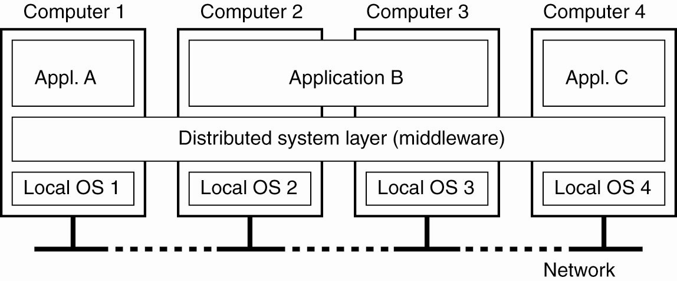
Definition of a Distributed System
Figure 1-1. A distributed system organized as middleware. The middleware layer runs on all machines, and offers a uniform interface to the system

Slide 17
Goal 1 – Resource Availability
Support user access to remote resources (printers, data files, web pages, CPU cycles) and the fair sharing of the resources
Economics of sharing expensive resources
Performance enhancement – due to multiple processors; also due to ease of collaboration and info exchange – access to remote services
Resource sharing introduces security problems.

Slide 18
Goal 2 – Distribution Transparency
Software hides some of the details of the distribution of system resources.
Makes the system more user friendly.
A distributed system that appears to its users & applications to be a single computer system is said to be transparent.
Users & apps should be able to access remote resources in the same way they access local resources.
Transparency has several dimensions.

Slide 19
Types of Transparency
Transparency | Description
Access | Hide differences in data representation & resource access (enables interoperability)
Location | Hide location of resource (can use resource without knowing its location)
Migration | Hide possibility that a system may change location of resource (no effect on access)
Replication | Hide the possibility that multiple copies of the resource exist (for reliability and/or availability)
Concurrency | Hide the possibility that the resource may be shared concurrently
Failure | Hide failure and recovery of the resource. How does one differentiate betw. slow and failed?
Relocation | Hide that resource may be moved during use
Figure 1-2. Different forms of transparency in a distributed system (ISO, 1995)

Slide 20
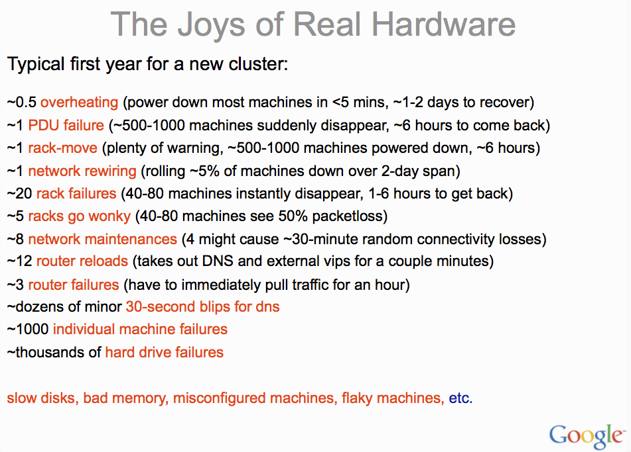
Transparency to Handle Failures?
slide from Jeff Dean, Google

Slide 21
Goal 2: Degrees of Transparency
Trade-off: transparency versus other factors
Reduced performance: multiple attempts to contact a remote server can slow down the system – should you report failure and let user cancel request?
Convenience: direct the print request to my local printer, not one on the next floor
Too much emphasis on transparency may prevent the user from understanding system behavior.
Notes:
Relate to extensible OS arguments.

Slide 22
Goal 3 - Openness
An open distributed system “…offers services according to standard rules that describe the syntax and semantics of those services.” In other words, the interfaces to the system are clearly specified and freely available.
Compare to network protocols, Not proprietary
Interface Definition/Description Languages (IDL): used to describe the interfaces between software components, usually in a distributed system
Definitions are language & machine independent
Support communication between systems using different OS/programming languages; e.g. a C++ program running on Windows communicates with a Java program running on UNIX
Communication is usually RPC-based.

Slide 23
Examples of IDLs Goal 3-Openness
IDL: Interface Description Language
The original
WSDL: Web Services Description Language
Provides machine-readable descriptions of the services
OMG IDL: used for RPC in CORBA
OMG – Object Management Group
…

Slide 24
Open Systems Support …
Interoperability: the ability of two different systems or applications to work together
A process that needs a service should be able to talk to any process that provides the service.
Multiple implementations of the same service may be provided, as long as the interface is maintained
Portability: an application designed to run on one distributed system can run on another system which implements the same interface.
Extensibility: Easy to add new components, features

Slide 25
Goal 4 - Scalability
Dimensions that may scale:
With respect to size
With respect to geographical distribution
With respect to the number of administrative organizations spanned
A scalable system still performs well as it scales up along any of the three dimensions.

Slide 26
Summary Goals for Distribution
Resource accessibility
For sharing and enhanced performance
Distribution transparency
For easier use
Openness
To support interoperability, portability, extensibility
Scalability
With respect to size (number of users), geographic distribution, administrative domains

Slide 27
Enough advertising
Let’s look at one real distributed system
That’s drastically more complex than it might seem from the web browser...

Slide 28
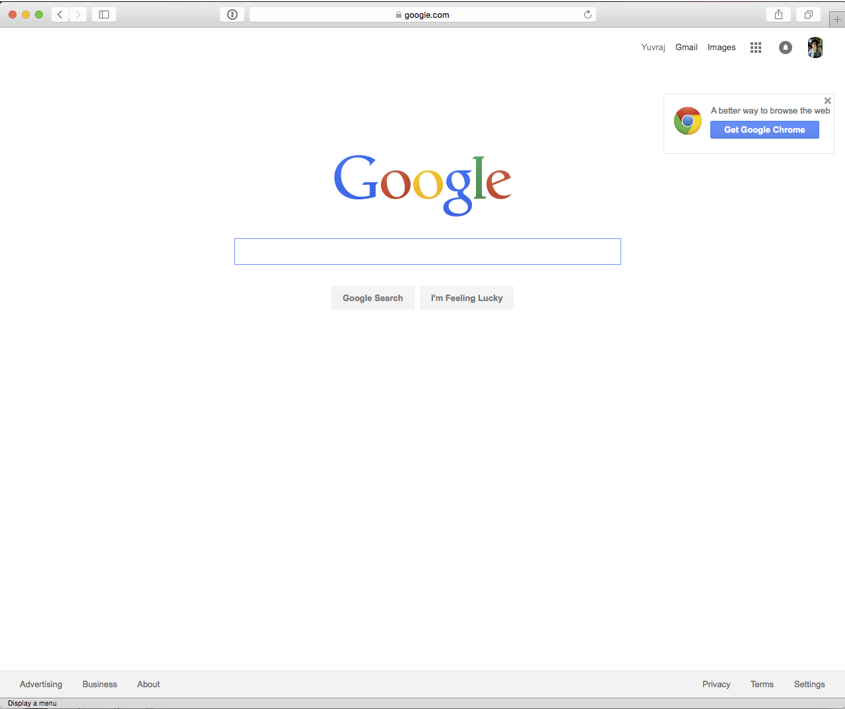

Slide 29
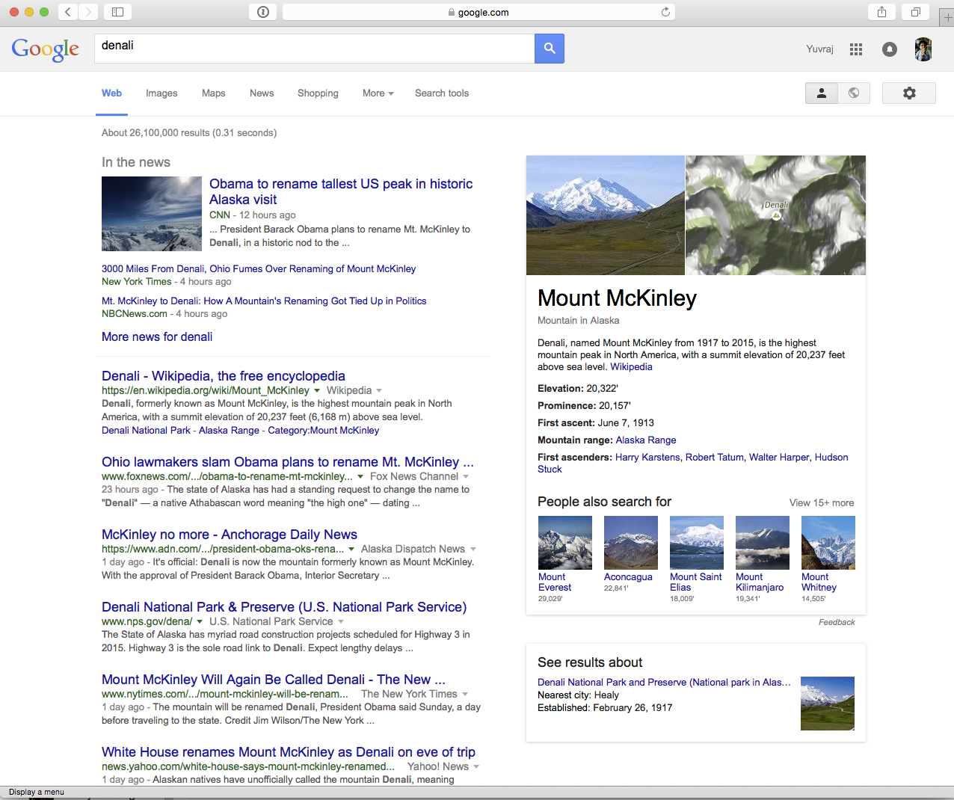
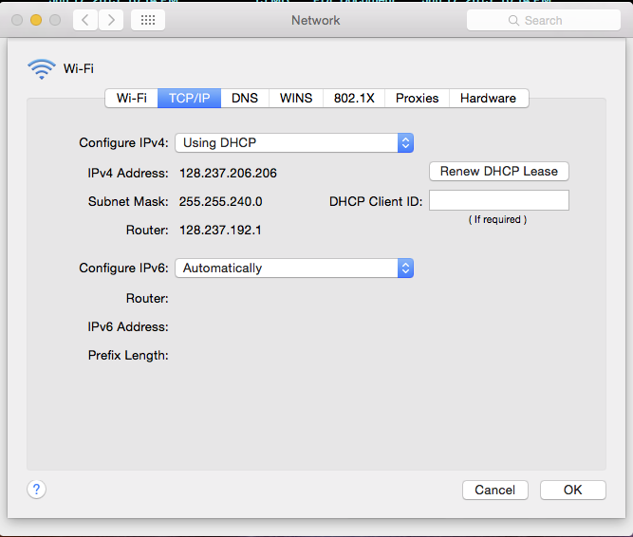

Slide 30

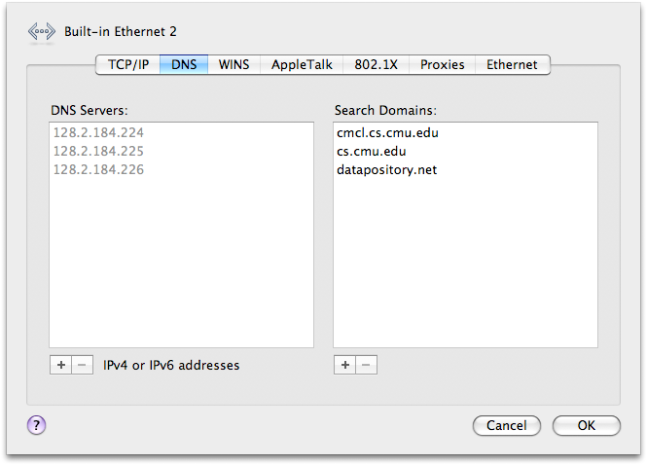
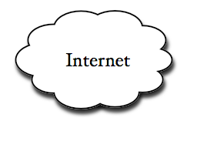
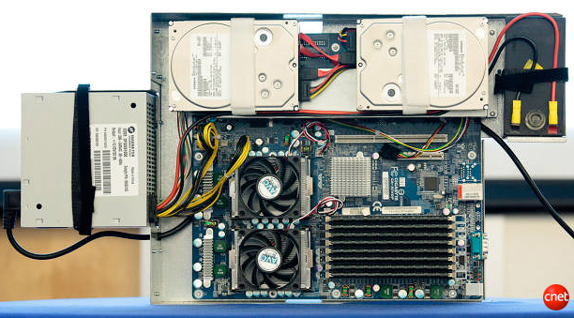
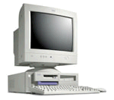
Remember IP...
hosts.txt
www.google.com 66.233.169.103
www.cmu.edu 128.2.185.33
www.cs.cmu.edu 128.2.56.91
www.areyouawake.com 66.93.60.192
...
From: 128.237.206.206
To: 66.233.169.103
<packet contents>

Slide 31
The Google Example
Note that URL: www.google.com
But your computer has an IP address...
Naming! The “Domain Name System”, or DNS, translates names to IP addresses
In the days of yore, this was a text file called “hosts.txt” that everyone periodically downloaded
Today, with hundreds of millions of domains...
It’s a big distributed system that allows people to update small parts (“moo.cmcl.cs.cmu.edu”) without coordinating with the owners of other parts. We’ll see this soon.

Slide 32
Domain Name System
. DNS server
`
CMU DNS server
who is www.google.com?
ask the .com guy... (here’s his IP)
who is www.google.com?
`
`
.com DNS server
ask the google.com guy... (IP)
`
Decentralized - admins update own domains without coordinating with other domains
Scalable - used for hundreds of millions of domains
Robust - handles load and failures well
www.google.com is 66.233.169.103
who is www.google.com?
66.233.169.103
google.com DNS server

Slide 33
But there’s more...
Which google datacenter is 128.237.206.206 closest to?
Is it too busy?
who is www.google.com?
`
128.237.206.206
Search!
66.233.169.99
google.com DNS server

Slide 34
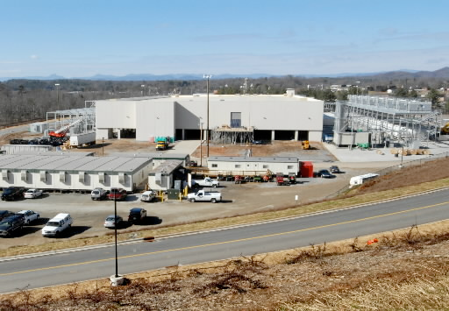
A Google Datacenter

Slide 35
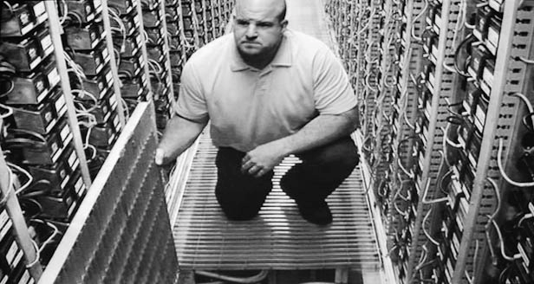
How big? Perhaps one million+ machines
but it’s not that bad...
usually don’t use more than 20,000 machines to accomplish a single task. [2009, probably out of date]

Slide 36
Search for Denali”
Front-end

Slide 37
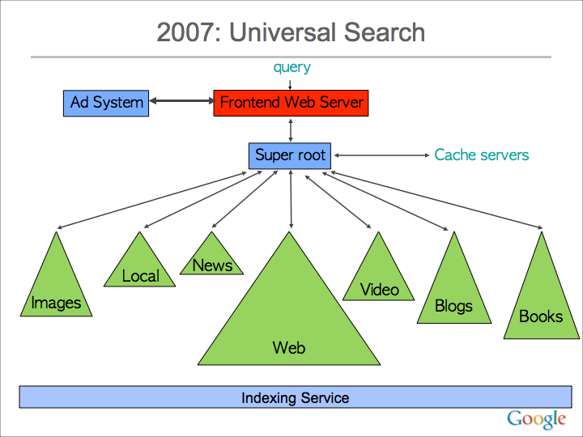
slide from Jeff Dean, Google

Slide 38
Front-end
Split into chunks: make single queries faster
Replicate: Handle load
i1
i2
i3
i1
i2
i3
i1
i2
i3
i4
...
i4
...
i4
...
Replicated
Consistent
Fast
GFS distributed filesystem

Slide 39
How do you index the web?
Get a copy of the web.
Build an index.
Profit.
There are over 1 trillion unique URLs
Billions of unique web pages
Hundreds of millions of websites
30?? terabytes of text

Slide 40
=
Crawling -- download those web pages
Indexing -- harness 10s of thousands of machines to do it
Profiting -- we leave that to you.
“Data-Intensive Computing”

Slide 41
MapReduce / Hadoop
Data Chunks
Why? Hiding details of programming 10,000 machines!
Programmer writes two simple functions:
map (data item) -> list(tmp values)
reduce ( list(tmp values)) -> list(out values)
MapReduce system balances load, handles failures, starts job, collects results, etc.
Computers
Sort
Storage
...
Data
Transformation
Data
Aggregation
Storage

Slide 42
All that...
Hundreds of DNS servers
Protocols on protocols on protocols
Distributed network of Internet routers to get packets around the globe
Hundreds of thousands of servers
... to find why Obama renamed a mountain?

Slide 43
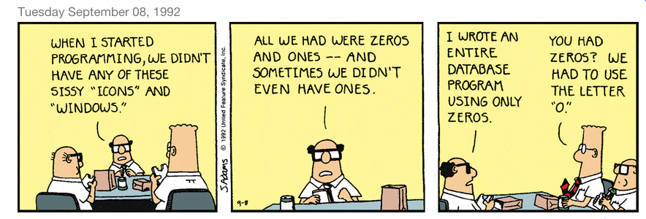
Thanks!

